Slide 1
CSIT 200
Python Programming
LinDa Yang
W-307

Slide 2
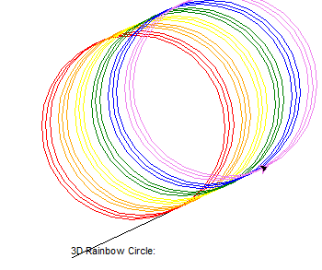
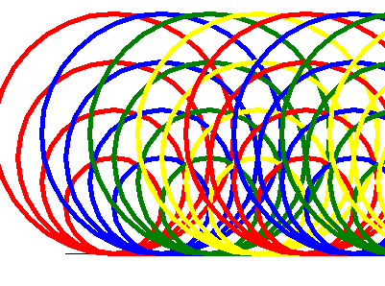

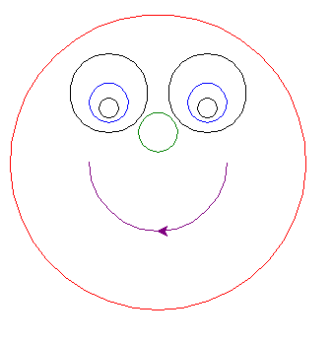
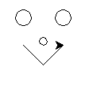
first…… Turtle Examples

Slide 3
XOR in Python?
Bitwise only!
X = 6
Y = 5
What is result? And why?

Slide 4
Switch Statements in Python?
No there are not!
Should you use if – elif chains?
Is there another way? Yes -→ dictionaries (later!)

Slide 5
Other stuff!
Sympy – library used for symbolic mathematics
https://www.sympy.org
https://docs.sympy.org › tutorial
If review: Dating equation!

Slide 6
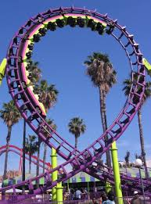
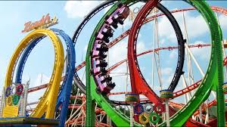
Overview – Week 4
Loops

Slide 7
Overview – Week 4
Implement while and for loops
Hand-trace the execution of a program
Become familiar with common loop algorithms
Understand nested loops
To use A computer for simulations
In this chapter, you will learn about loop statements in python, as well as techniques for writing programs that simulate activities in the real world.

Slide 8
Loops: what are they?
Repetition
Condition
Iteration
Infinite Loop

Slide 9
While statEment
Syntax:
while boolean expression:
statements(s)
…
next statement outside loop

Slide 10
While statEment
counter = 0
while counter < 5:
print(counter, end=" ")
counter += 1
print("\nThe loop has ended.")
Output
0 1 2 3 4
The loop has ended.

Slide 11
While statement
# Create constant variables.
RATE = 5.0
INITIAL_BALANCE = 10000.0
TARGET = 2 * initial_balance
# Initialize variables used with the loop.
balance = initial_balance
year = 0
# Count the years required for the investment to double.
while balance < TARGET :
year = year + 1
interest = balance * RATE / 100
balance = balance + interest
# Print the results.
Print("the investment doubled after", year, "years.")

Slide 12
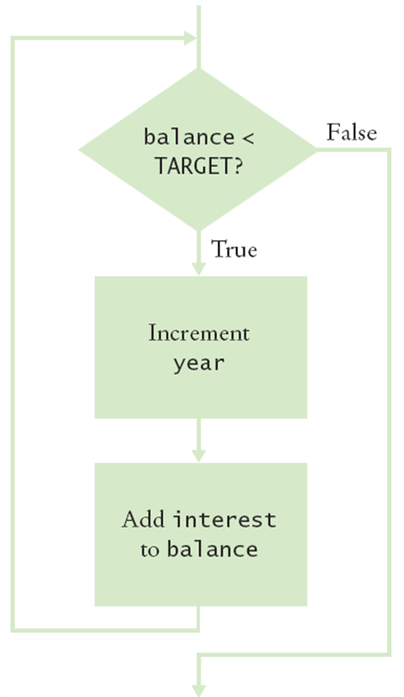
While statement
# Create constant variables.
RATE = 5.0
INITIAL_BALANCE = 10000.0
TARGET = 2 * initial_balance
# Initialize variables used with the loop.
balance = initial_balance
year = 0
# Count the years required for the investment to double.
while balance < TARGET :
year = year + 1
interest = balance * RATE / 100
balance = balance + interest
# Print the results.
Print("the investment doubled after", year, "years.")

Slide 13
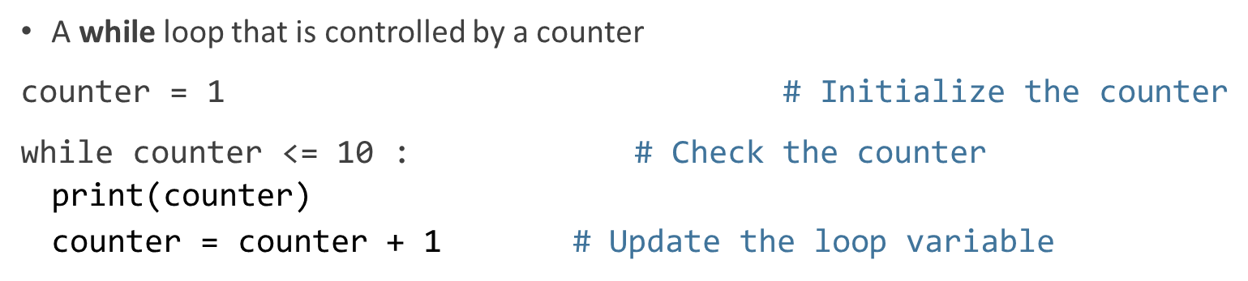
While statement
Do NOT use while(True) :

Slide 14
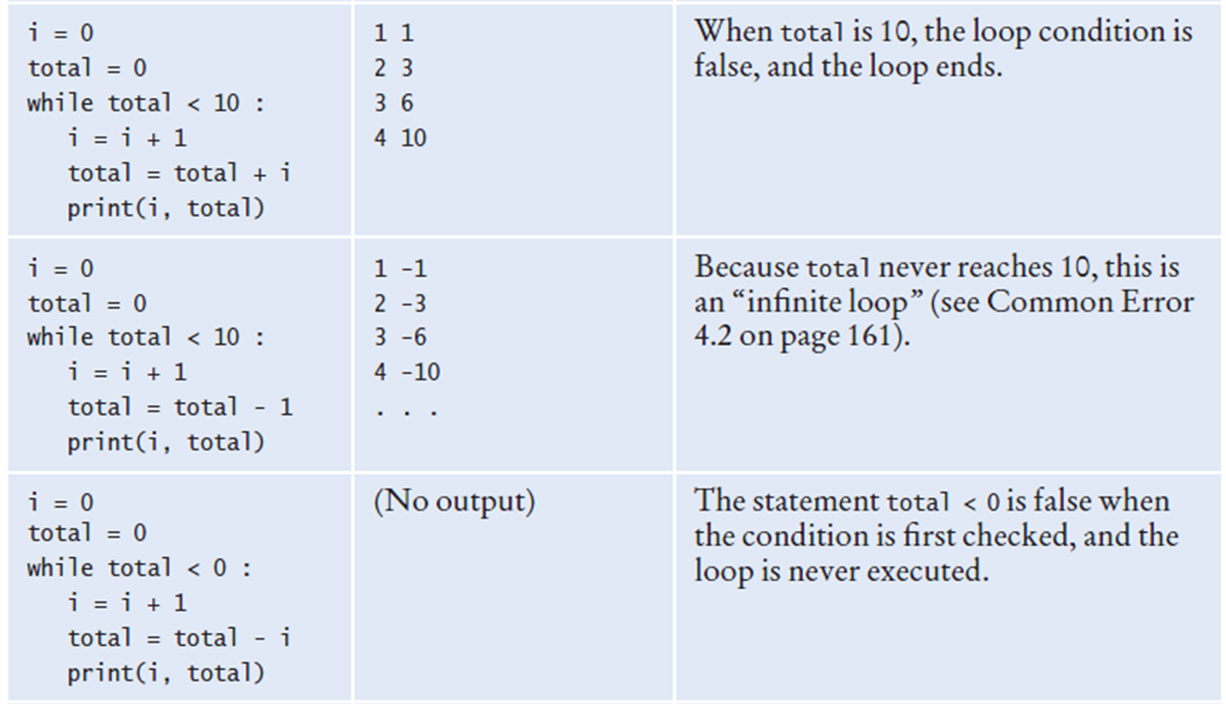
While Loop examples

Slide 15
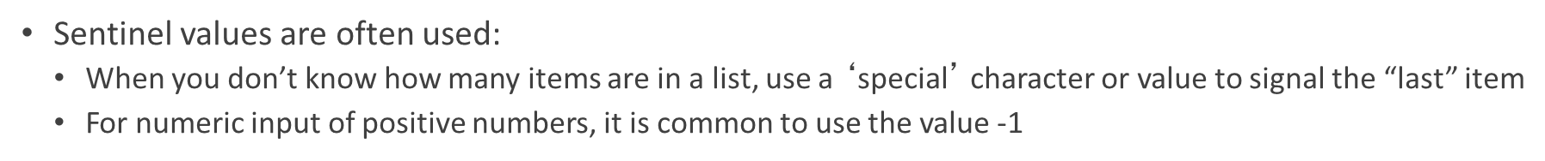
Sentinel values

Slide 16
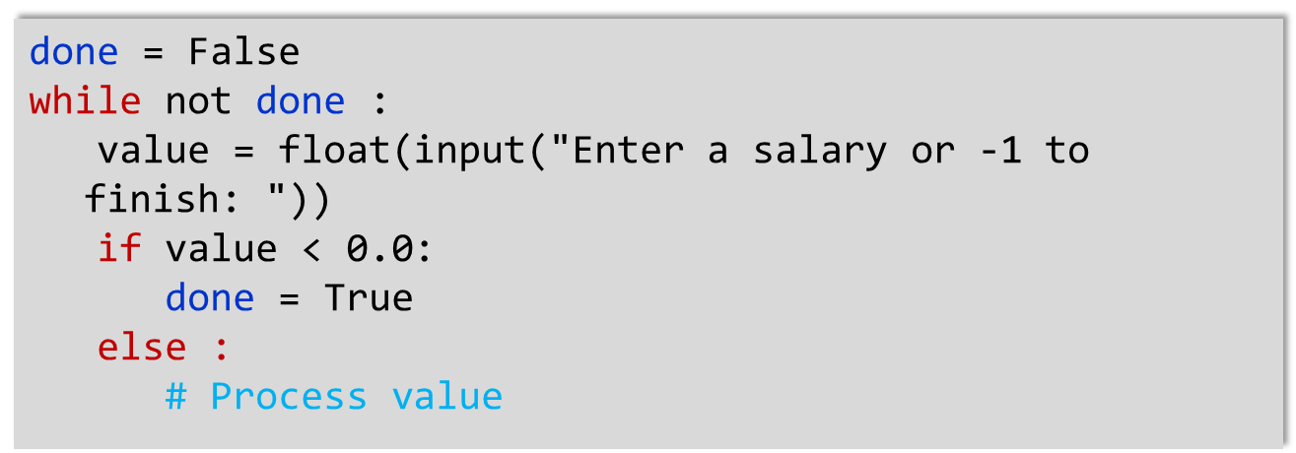
Boolean controlled loop
A boolean variable can be used to control a loop
Sometimes called a ‘flag’ variable

Slide 17
While loop summary
While loops are very common
Initialize variables before you test
The condition is tested BEFORE the loop body
This is called pre-test
The condition often uses a counter variable
Something inside the loop should change one of the variables used in the test
Watch out for infinite loops!
Loops can be used for input validation
You can use a sentinel
Make sure you have a way out of the loop
You can also nest loops

Slide 18
While loop common errors
Incorrect Boolean test condition
Infinite loop
Off by 1!
Forgetting to update counter in the loop

Slide 19
Let’s not forget about storyboards
One useful problem solving technique is the use of storyboards to model user interaction. It can help answer:
What information does the user provide, and in which order?
What information will your program display, and in which format?
What should happen when there is an error?
When does the program quit?
A storyboard consists of annotated sketches for each step in an action sequence.

Slide 20
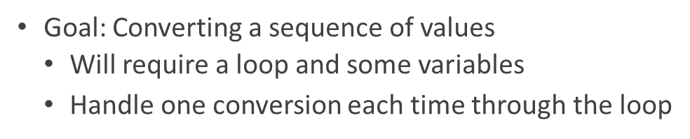
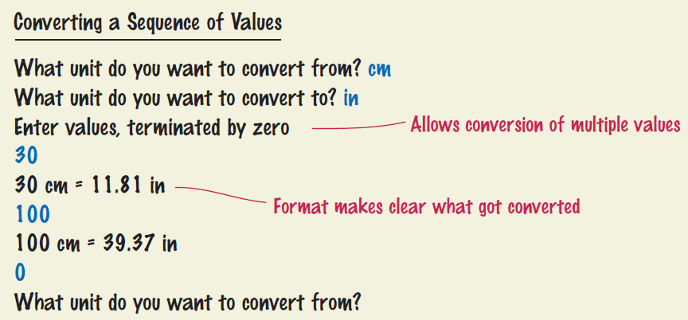
Storyboard Example

Slide 21
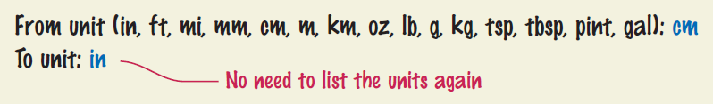
List what can go wrong!
Unknown unit types
What if the user misspells centimeters and inches?
What other conversions are available?
Solution:
Show a list of the acceptable unit types

Slide 22
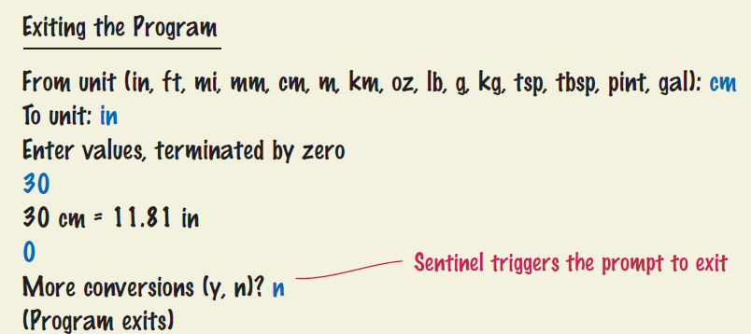
Decide how to exit the code
How does the user quit the program?

Slide 23
The for loop
Uses of a for loop:
The for loop can be used to iterate over the contents of any container.
A container is an object (Like a string) that contains or stores a collection of elements
A string is a container that stores the collection of characters in the string
The container can be any collection of elements

Slide 24
The for loop
for num in [0, 1, 2, 3, 4]:
print(num)

Slide 25
For Loop
Note an important difference between the while loop and the for loop.
In the while loop, the index variable i is assigned 0, 1, and so on.
In the for loop, the element variable is assigned stateName[0], stateName[1], and so on.
stateName = "Virginia"
i = 0
while i < len(stateName) :
letter = stateName[i]
print(letter)
i = i + 1
stateName = "Virginia"
for letter in stateName :
print(letter)

Slide 26
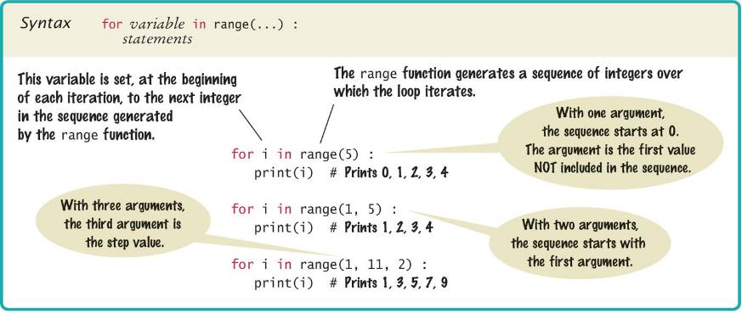
For Loop
You can use a for loop as a count-controlled loop to iterate over a range of integer values
We use the range function for generating a sequence of integers that less than the argument that can be used with the for loop

Slide 27
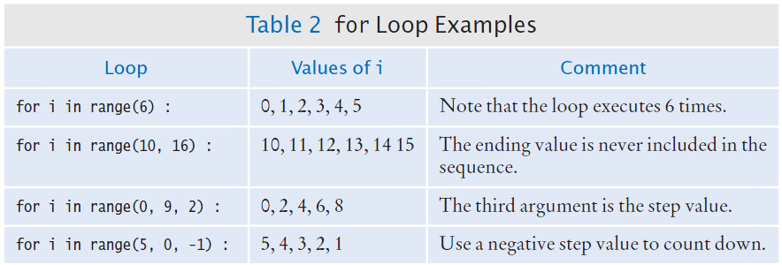
Examples

Slide 28
consideration
Finding the correct lower and upper bounds for a loop can be confusing.
Should you start at 0 or at 1?
Should you use <= value or < value as a termination condition?

Slide 29
For loop summary
for loops are very powerful
The for loop can be used to iterate over the contents of any container, which is an object that contains or stores a collection of elements
a string is a container that stores the collection of characters in the string.
A for loop can also be used as a count-controlled loop that iterates over a range of integer values.

Slide 30
Nested Loops
In Chapter Three we learned how to nest if statements to allow us to make complex decisions
Remember that to nest the if statements we need to indent the code block
Complex problems sometimes require a nested loop, one loop nested inside another loop
The nested loop will be indented inside the code block of the first loop
A good example of using nested loops is when you are processing cells in a table
The outer loop iterates over all of the rows in the table
The inner loop processes the columns in the current row

Slide 31
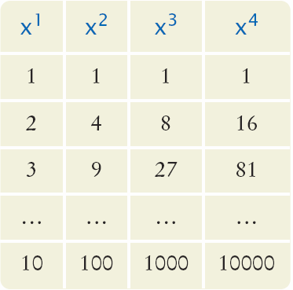
Nested loops
How would you print a table with rows and columns?
Print top line (header)
Use a for loop
Print table body…
How many rows are in the table?
How many columns in the table?
Loop per row
Loop per column
In our example there are:
Four columns in the table
Ten rows in the table

Slide 32
Nested loops
Print the table header
for x from 1 to 10
print a new table row
print a new line
How do we print a table row?
For n from 1 to 4
print x^{n}
We have to place this loop inside the preceding loop
The inner loop is “nested” inside the outer loop

Slide 33
Nested loops
Print the table header:
for x from 1 to 10
for n from 1 to 4
print X^{n}
print a new line

Slide 34
Flowchart of a Nested Loop
x = 1
x <= 10?
True
n= 1
Inner Loop
False
n <= 4?
True
Print x^{n}
False
n = n + 1
Print new line
x = x + 1
Done

Slide 35
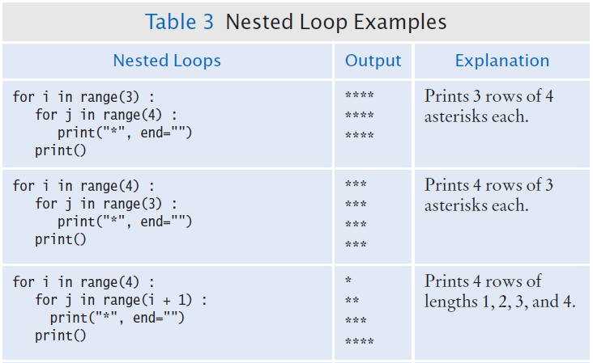
Nested loop examples

Slide 36
Break and continue
Use break and continue judiciously
Some say it is bad form to use
I say in certain situations it is ok but NOT all the time

